Slide 1
VisRAG
DocParse
Younghyeok Kim

Slide 2
Architecture

Slide 3
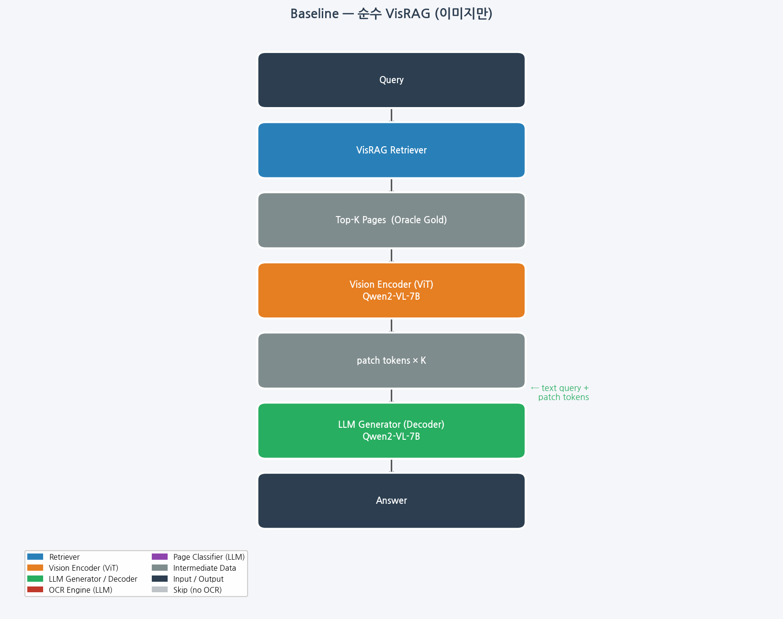
VisRAG Architecture Diagram

Slide 4
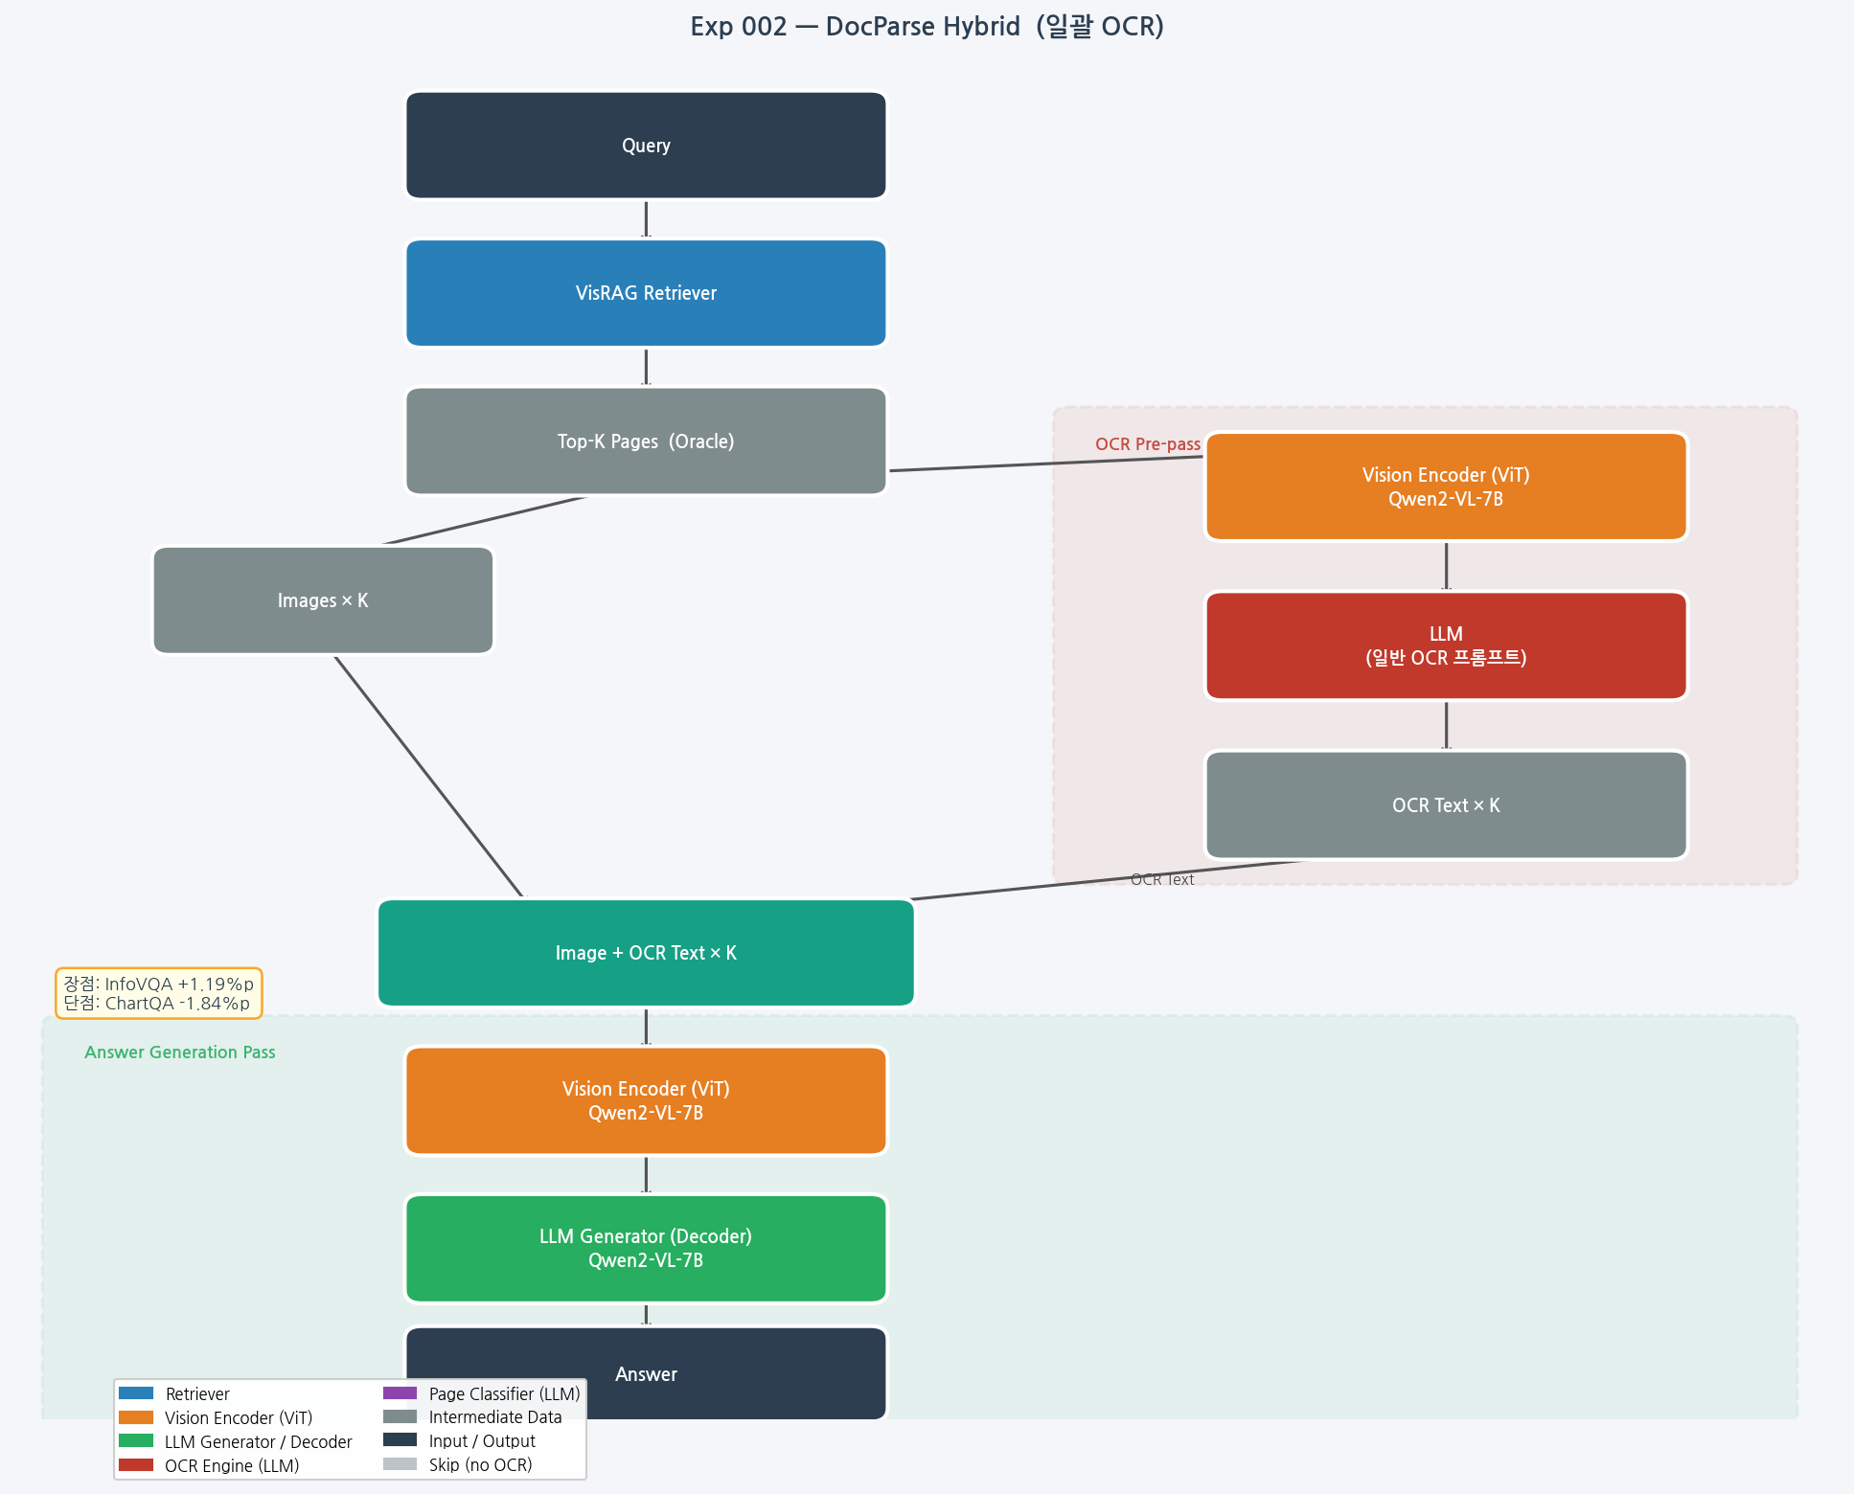
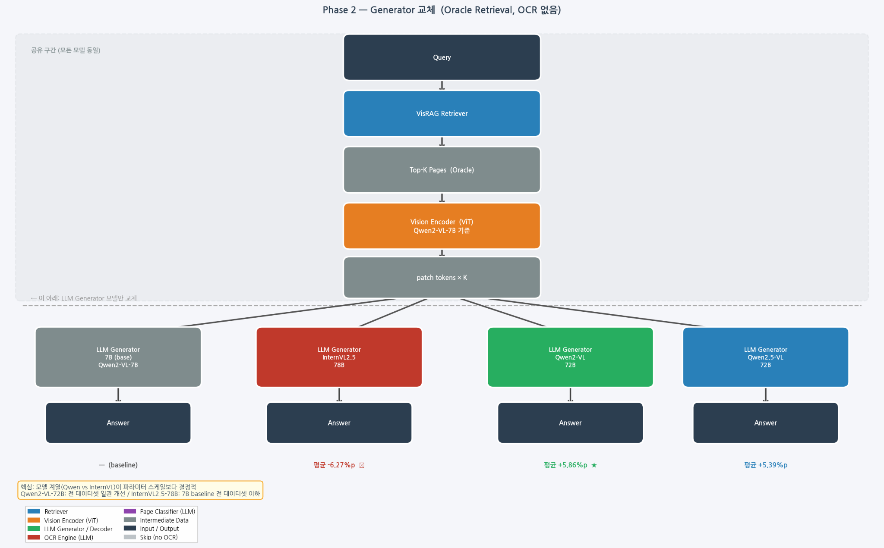
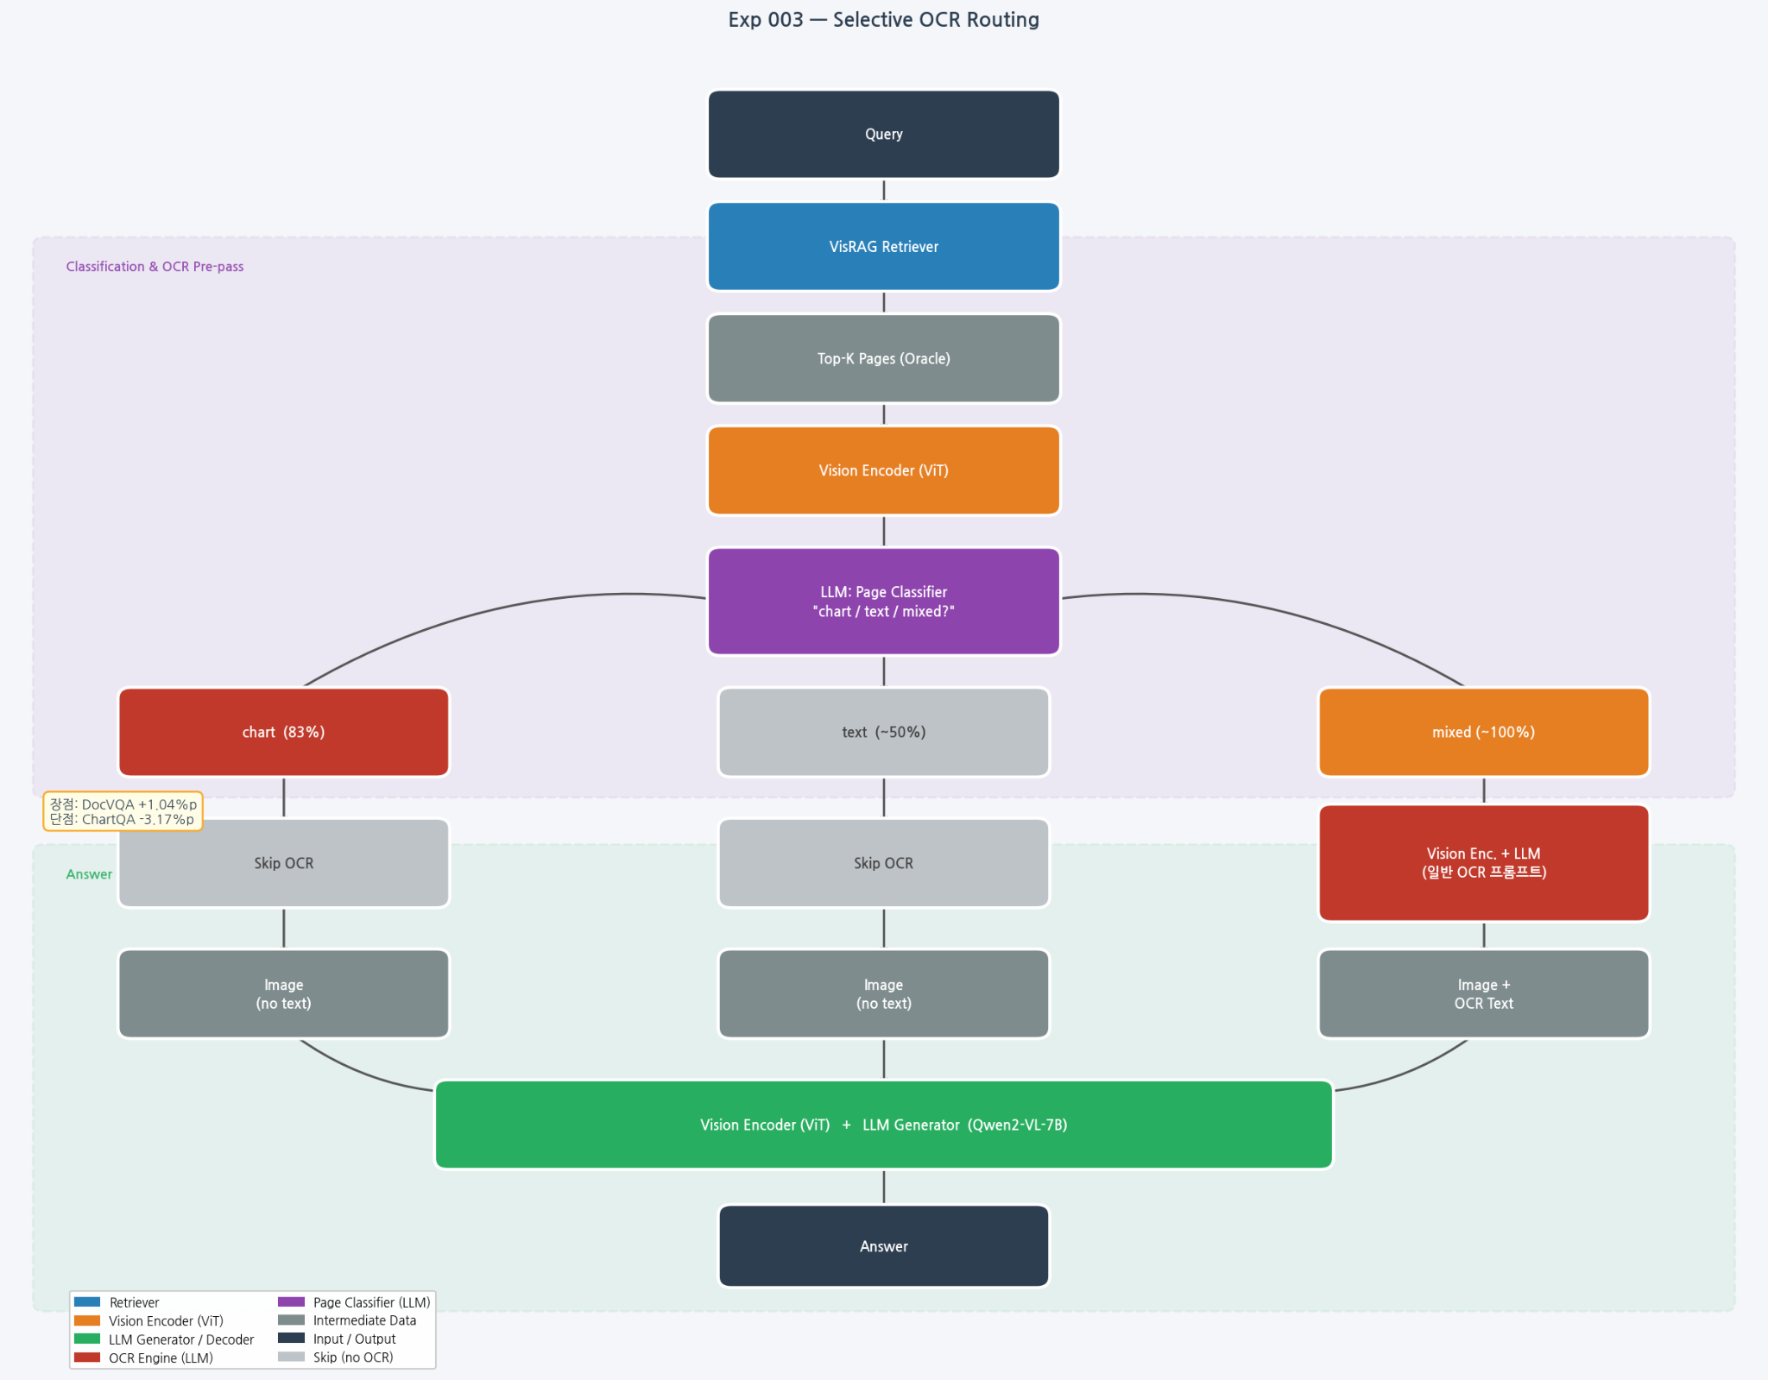
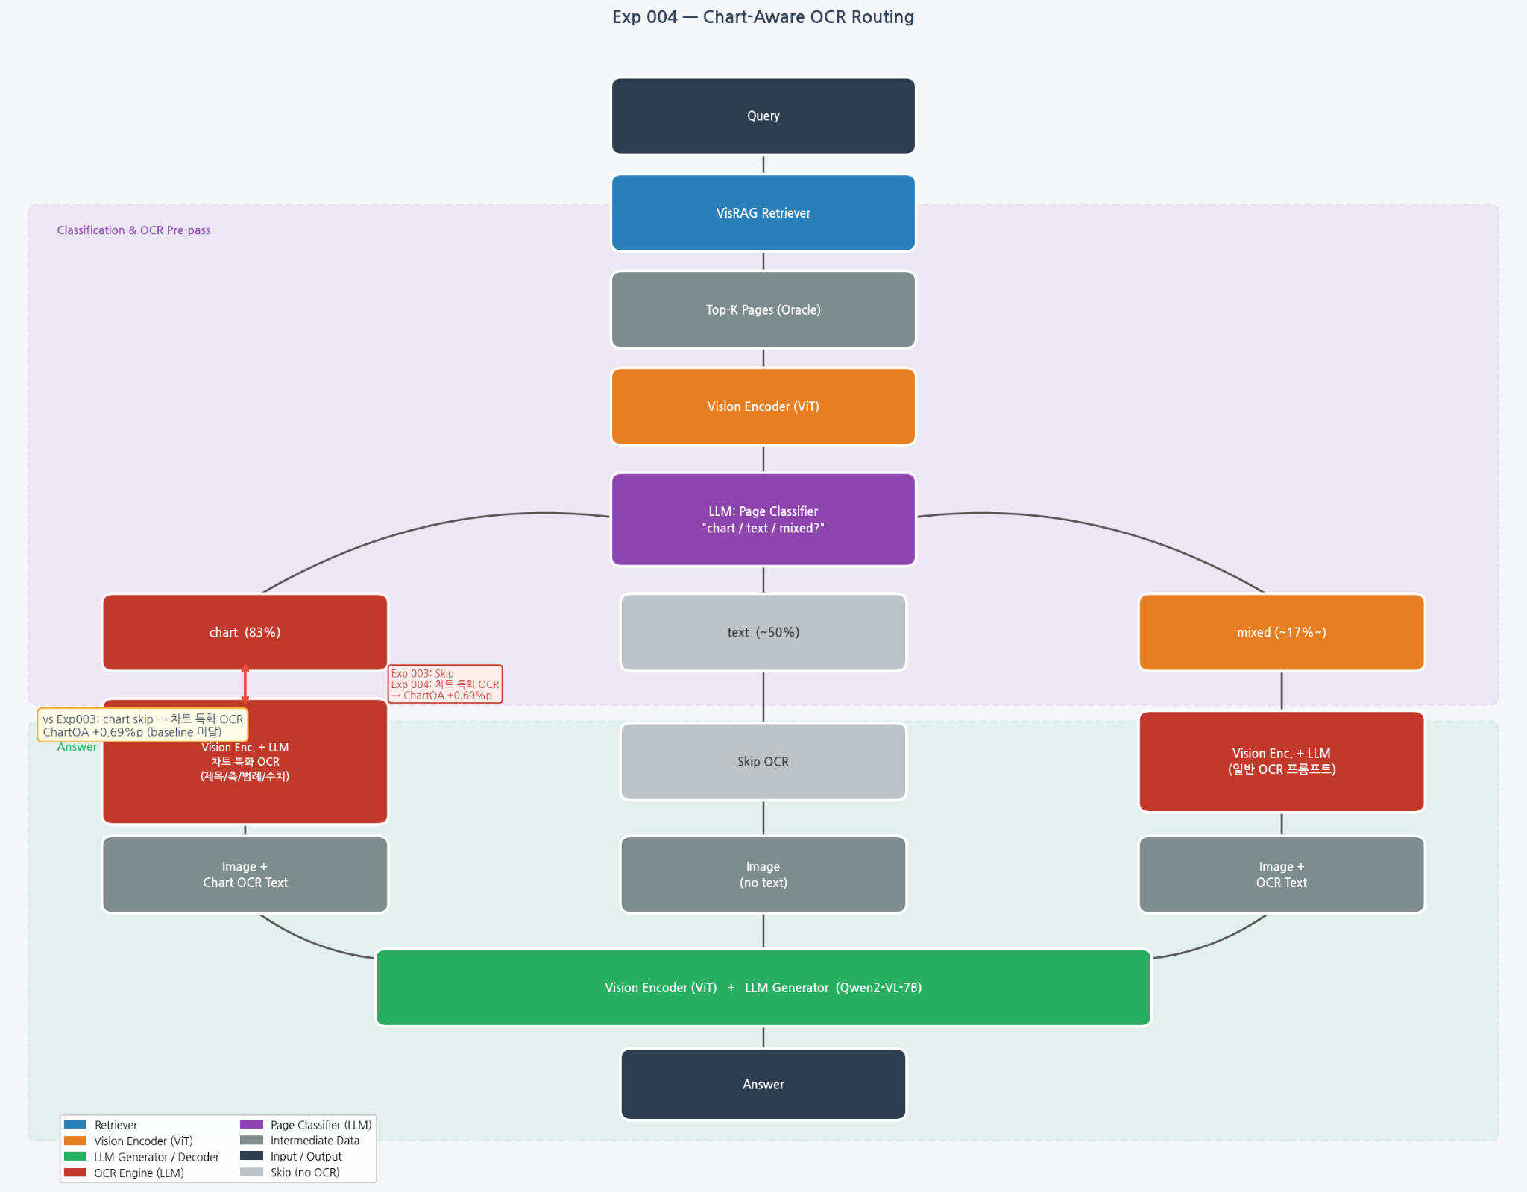
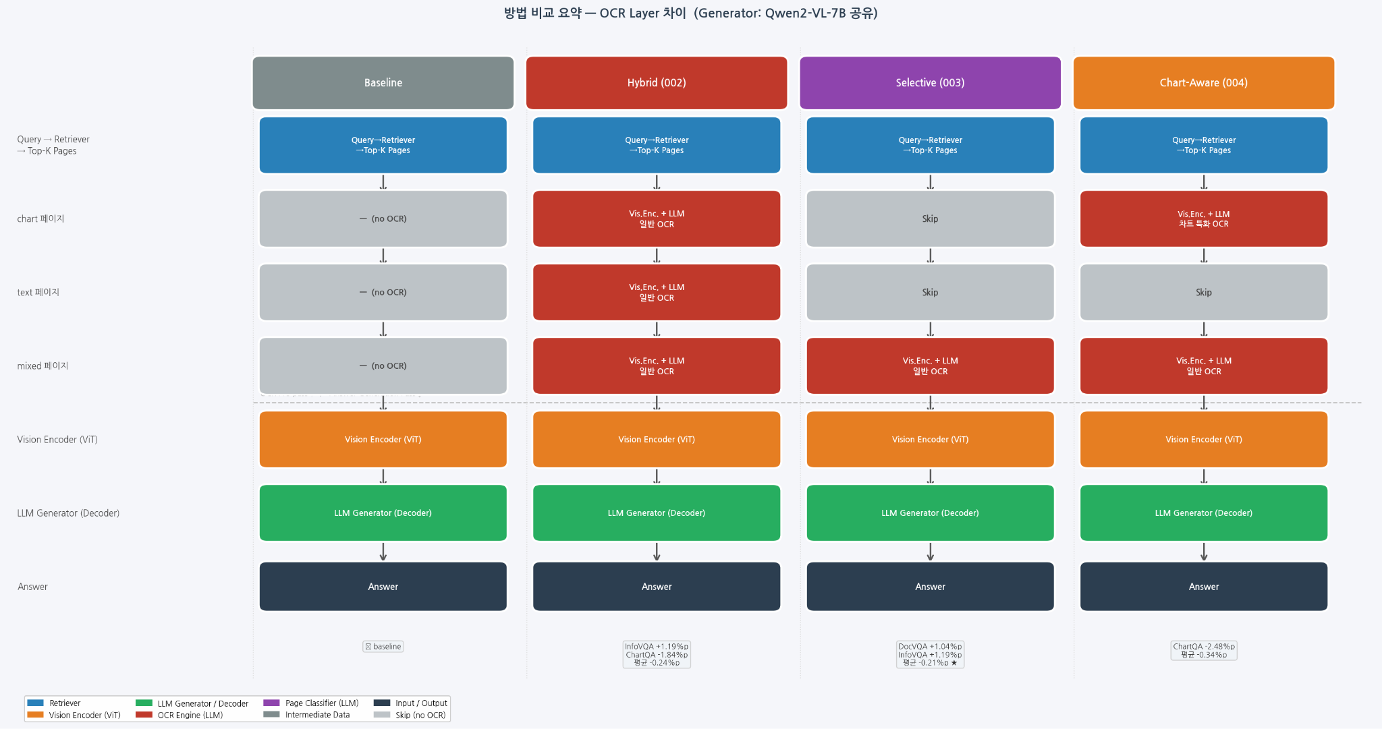
VisRAG Architecture Diagram

Slide 5
DocParse Architecture Diagram

Slide 6
Selective Routing Architecture Diagram

Slide 7
Chart Aware Routing Architecture Diagram

Slide 8
VisRAG Architecture Diagram

Slide 9
Architecture Diagram Summary

Slide 10
Results
Method | InfoVQA | ChartQA | DocVQA | SlideVQA | 평균 Δ vs Baseline
Baseline (순수 VisRAG) | 0.7835 | 0.6941 | 0.9303 | 0.7458 | —
Hybrid (002) (일괄 OCR) | 0.7954 | 0.6757 | 0.9259 | 0.7472 | -0.24%p
Selective (003) (mixed만 OCR) | 0.7954 | 0.6624 | 0.9407 | 0.7469 | -0.21%p
Chart-Aware (004) (chart 특화 OCR) | 0.7954 | 0.6693 | 0.9341 | 0.7412 | -0.34%p
Generator Model | ChartQA | DocVQA | InfoVQA | SlideVQA | 평균 Δ vs 7B
Qwen2-VL-7B (baseline) | 0.6941 | 0.9303 | 0.7835 | 0.7458 | —
InternVL2.5-78B | 0.6709 | 0.8939 | 0.6076 | 0.7304 | -6.27%p ✗
Qwen2-VL-72B | 0.7770 | 0.9657 | 0.8690 | 0.7762 | +5.86%p ★
Qwen2.5-VL-72B | 0.7349 | 0.9664 | 0.8854 | 0.7664 | +5.39%p

Slide 11
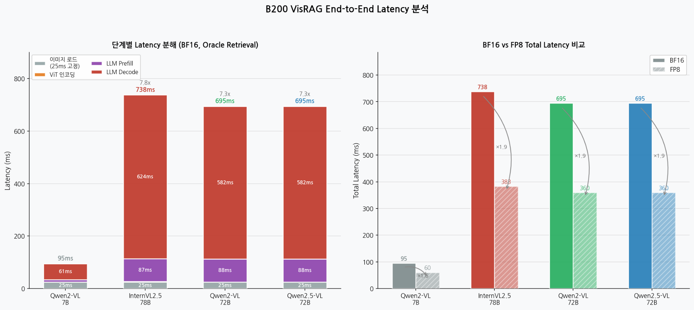
Results

